Slide 1
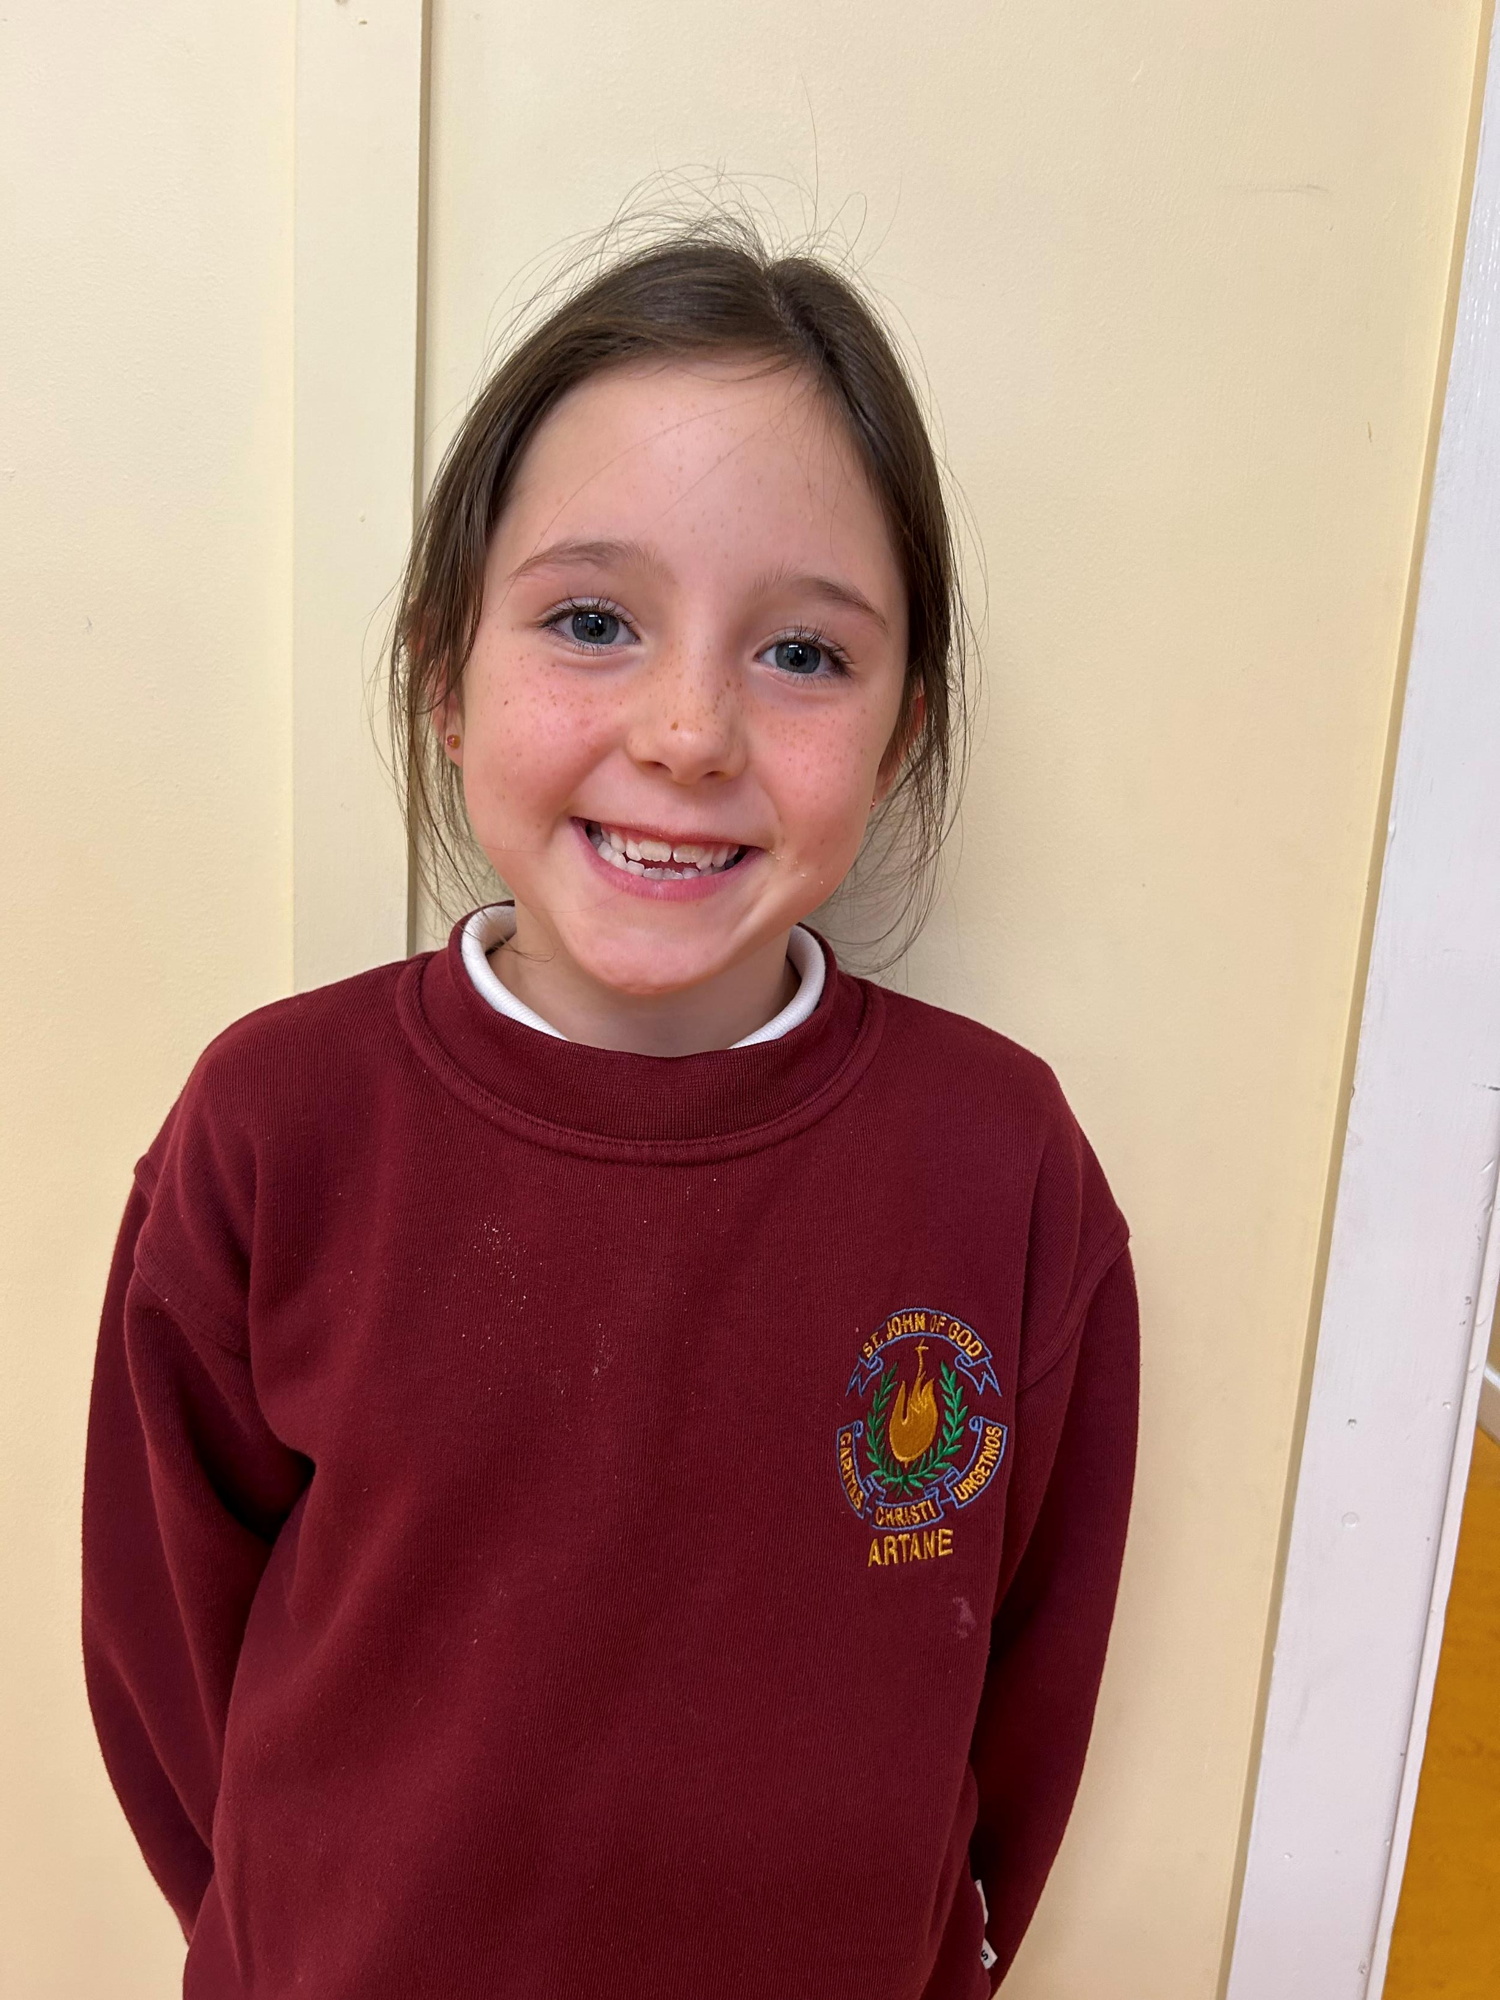
Halle 2nd Class
Age: 7
Favourite sport: Gymnastics
“ I wanted to join the active school committee because I love being active!”

Slide 2
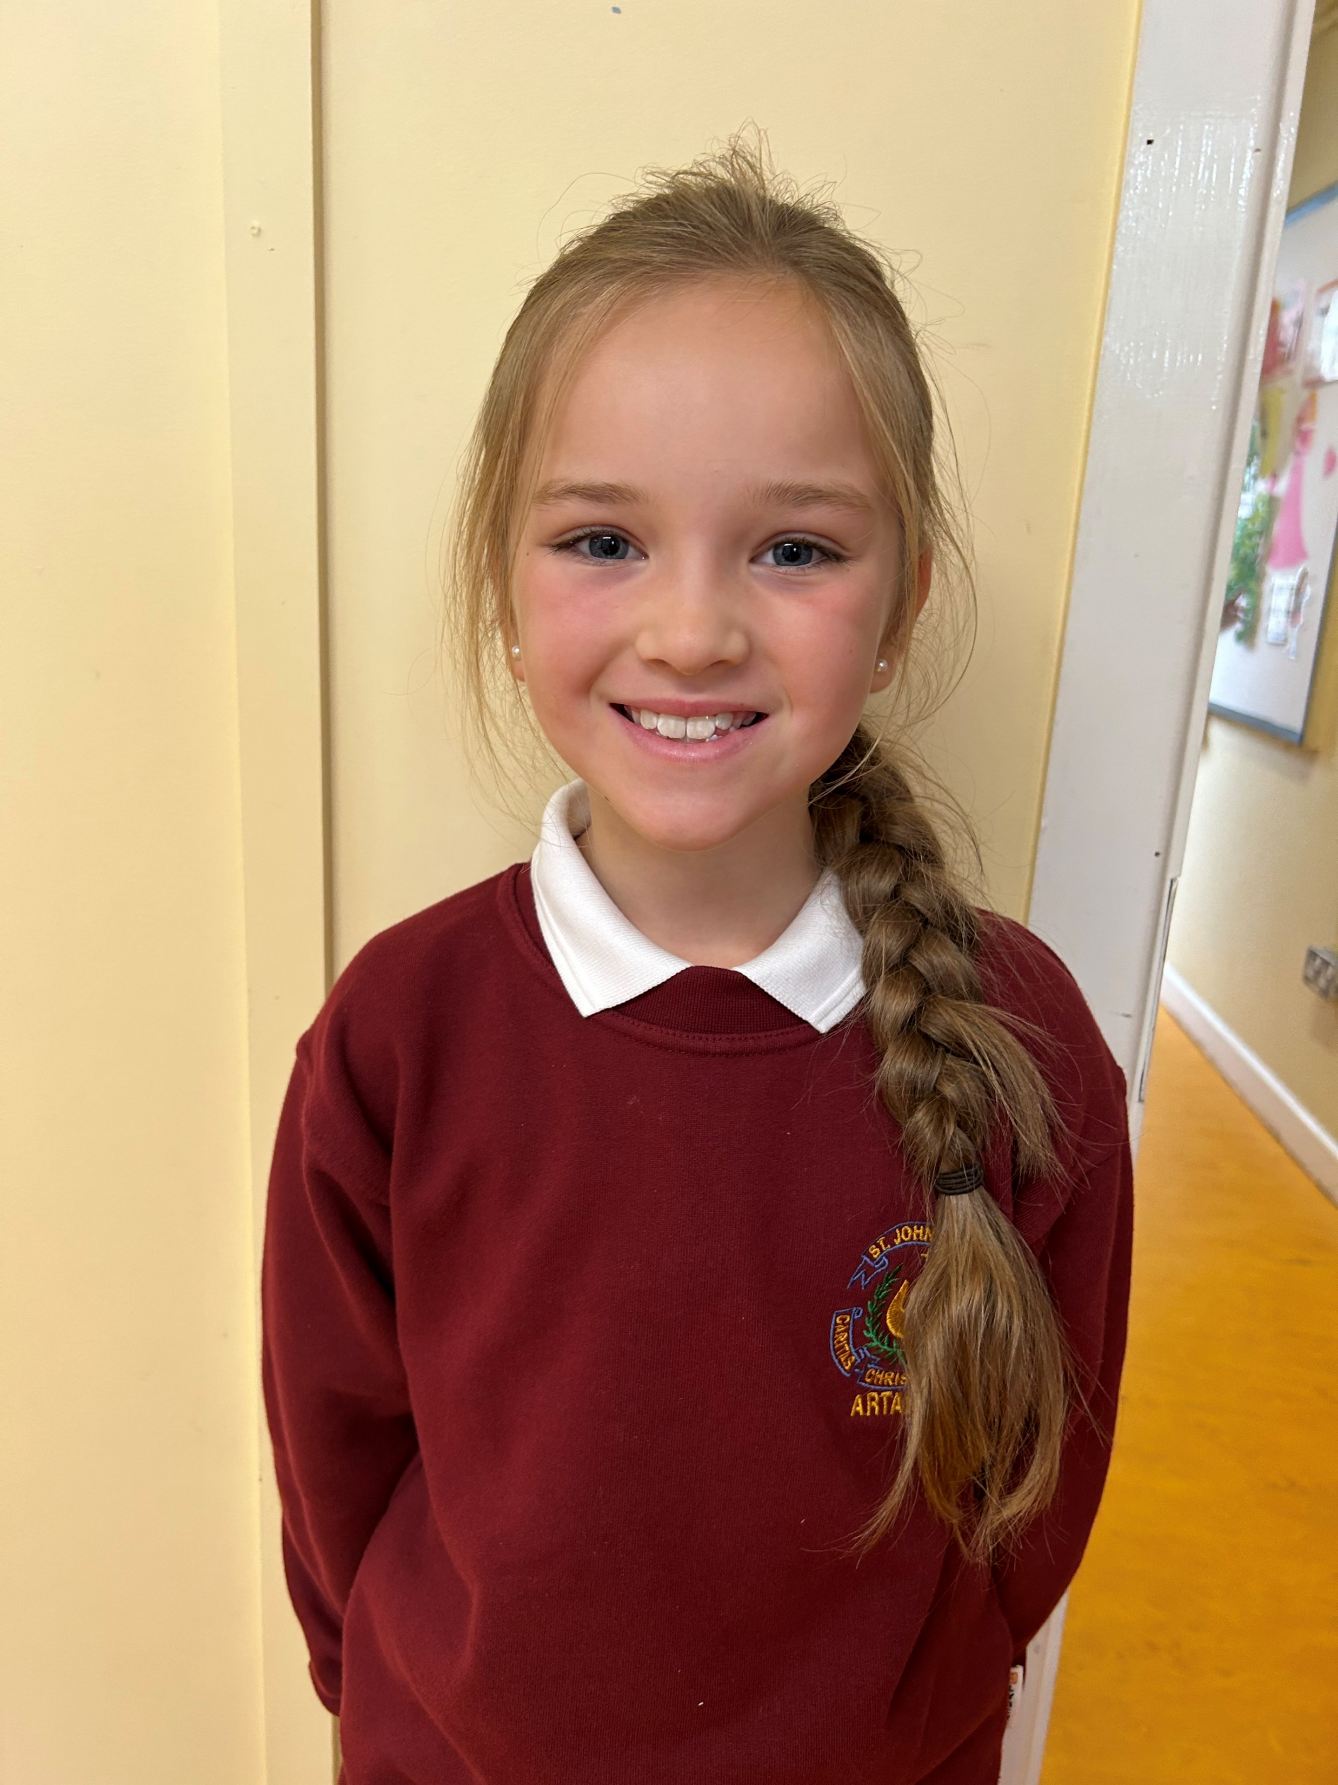
Ava 2nd Class
Age: 7
Favourite sport: Football
“ I wanted to join the active school committee because I love sport and being healthy!”

Slide 3
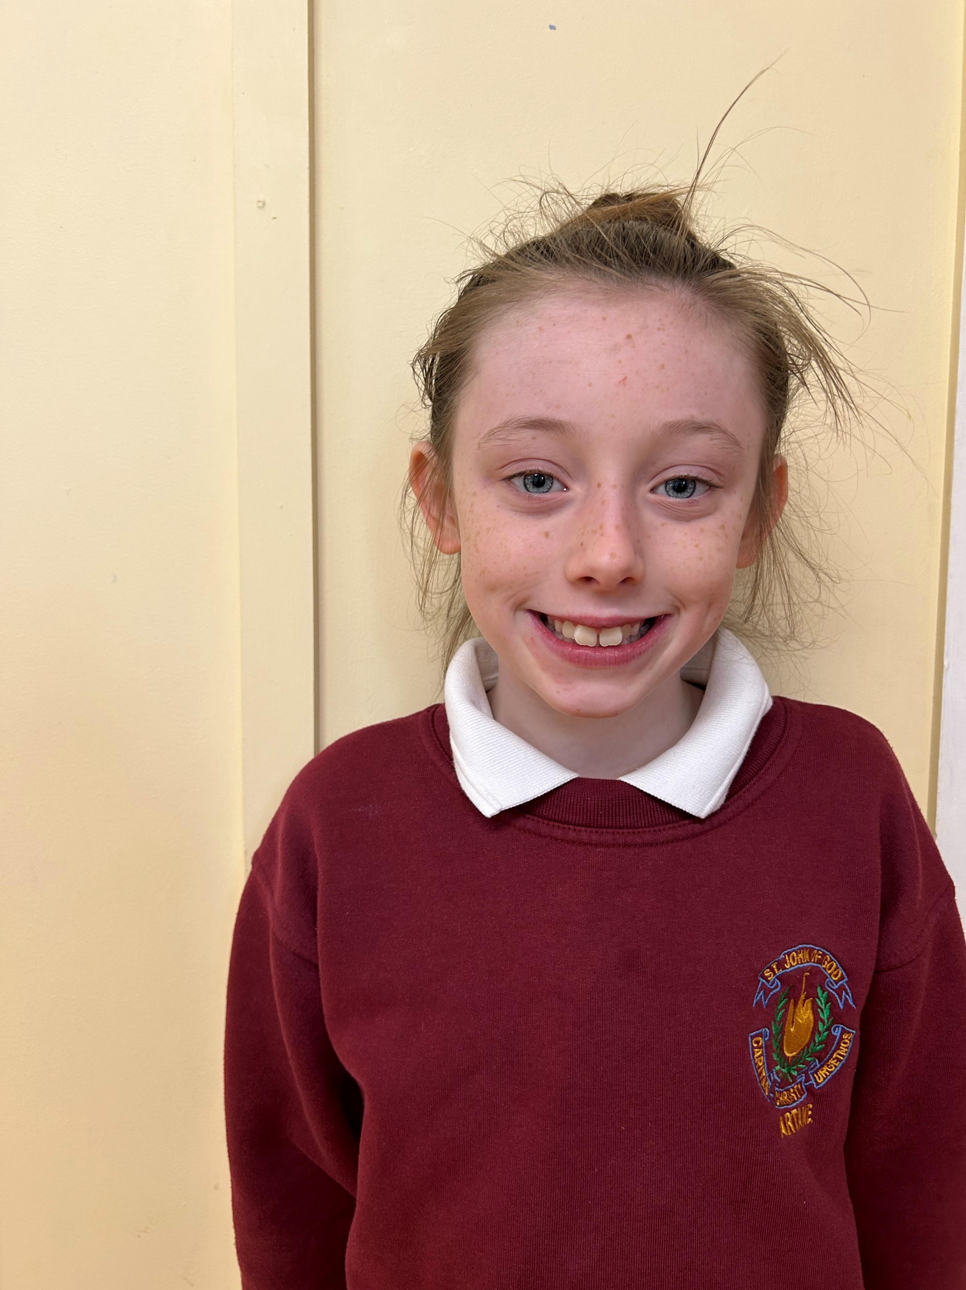
Arella 3d Class
Age: 9
Favourite sport: Dance
“I love being active, its so good for you!”

Slide 4
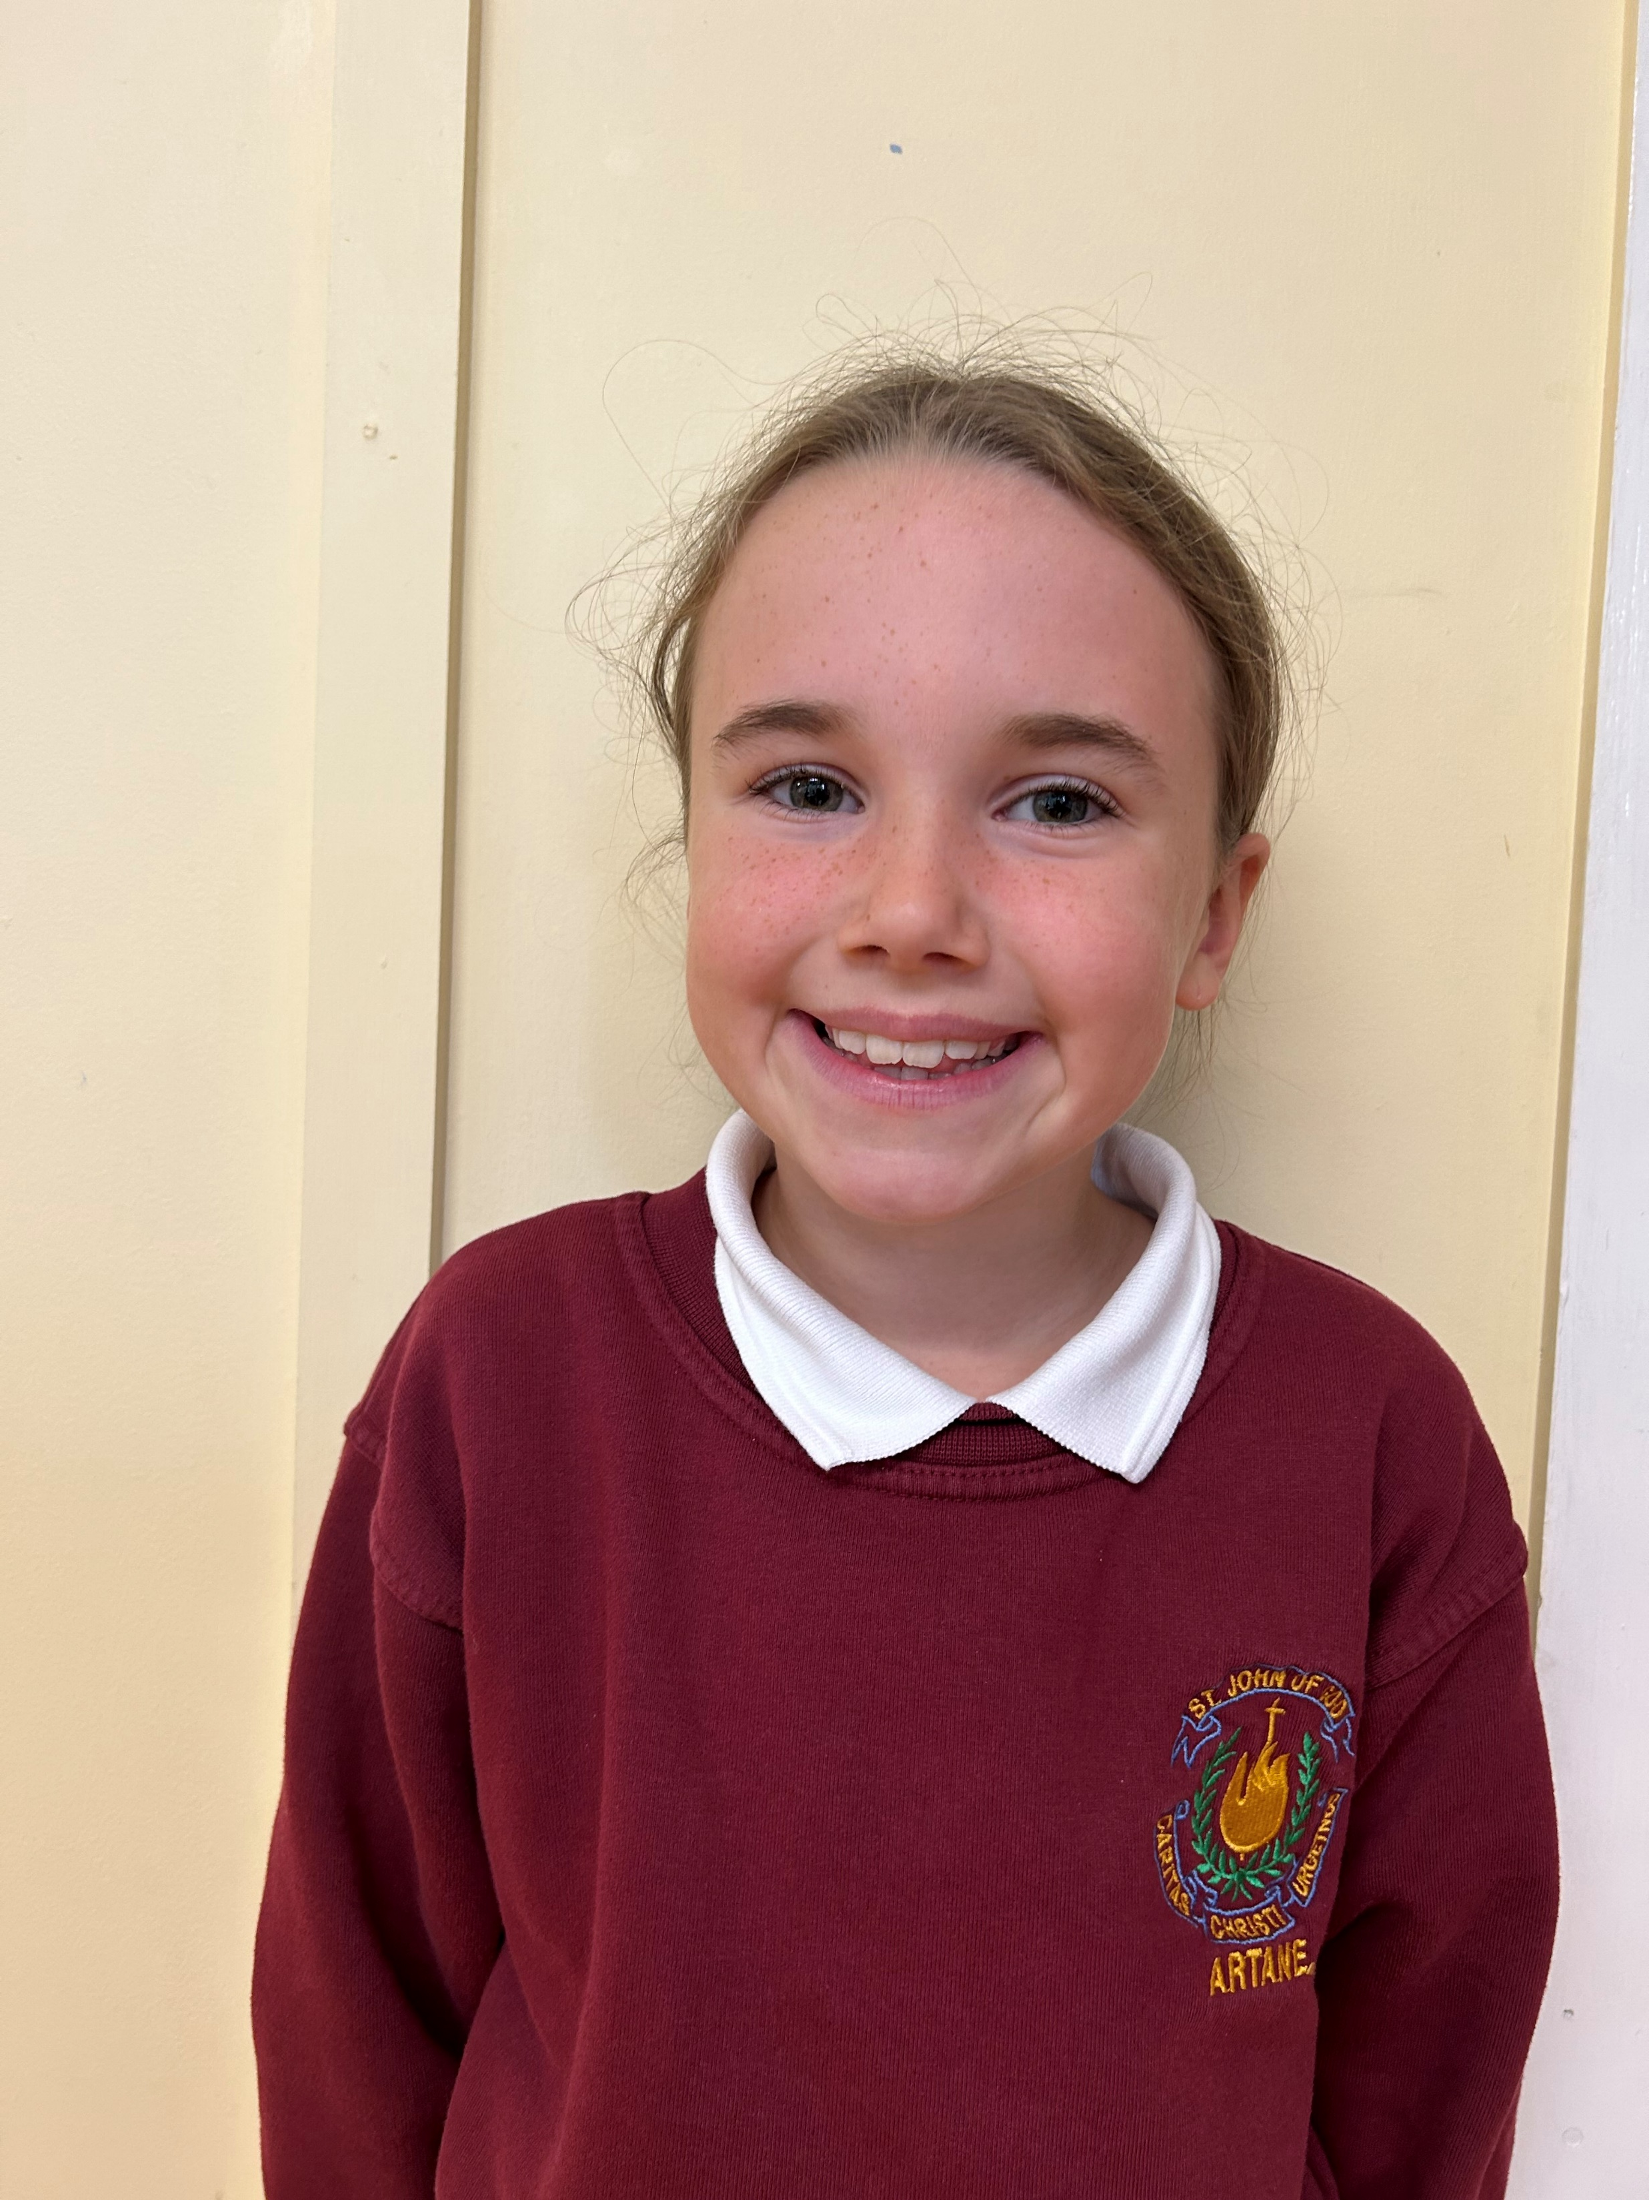
Lucy 3rd Class
Age: 9
Favourite sport: Dancing & GAA
“I love being active and I want everyone else to be too!”

Slide 5
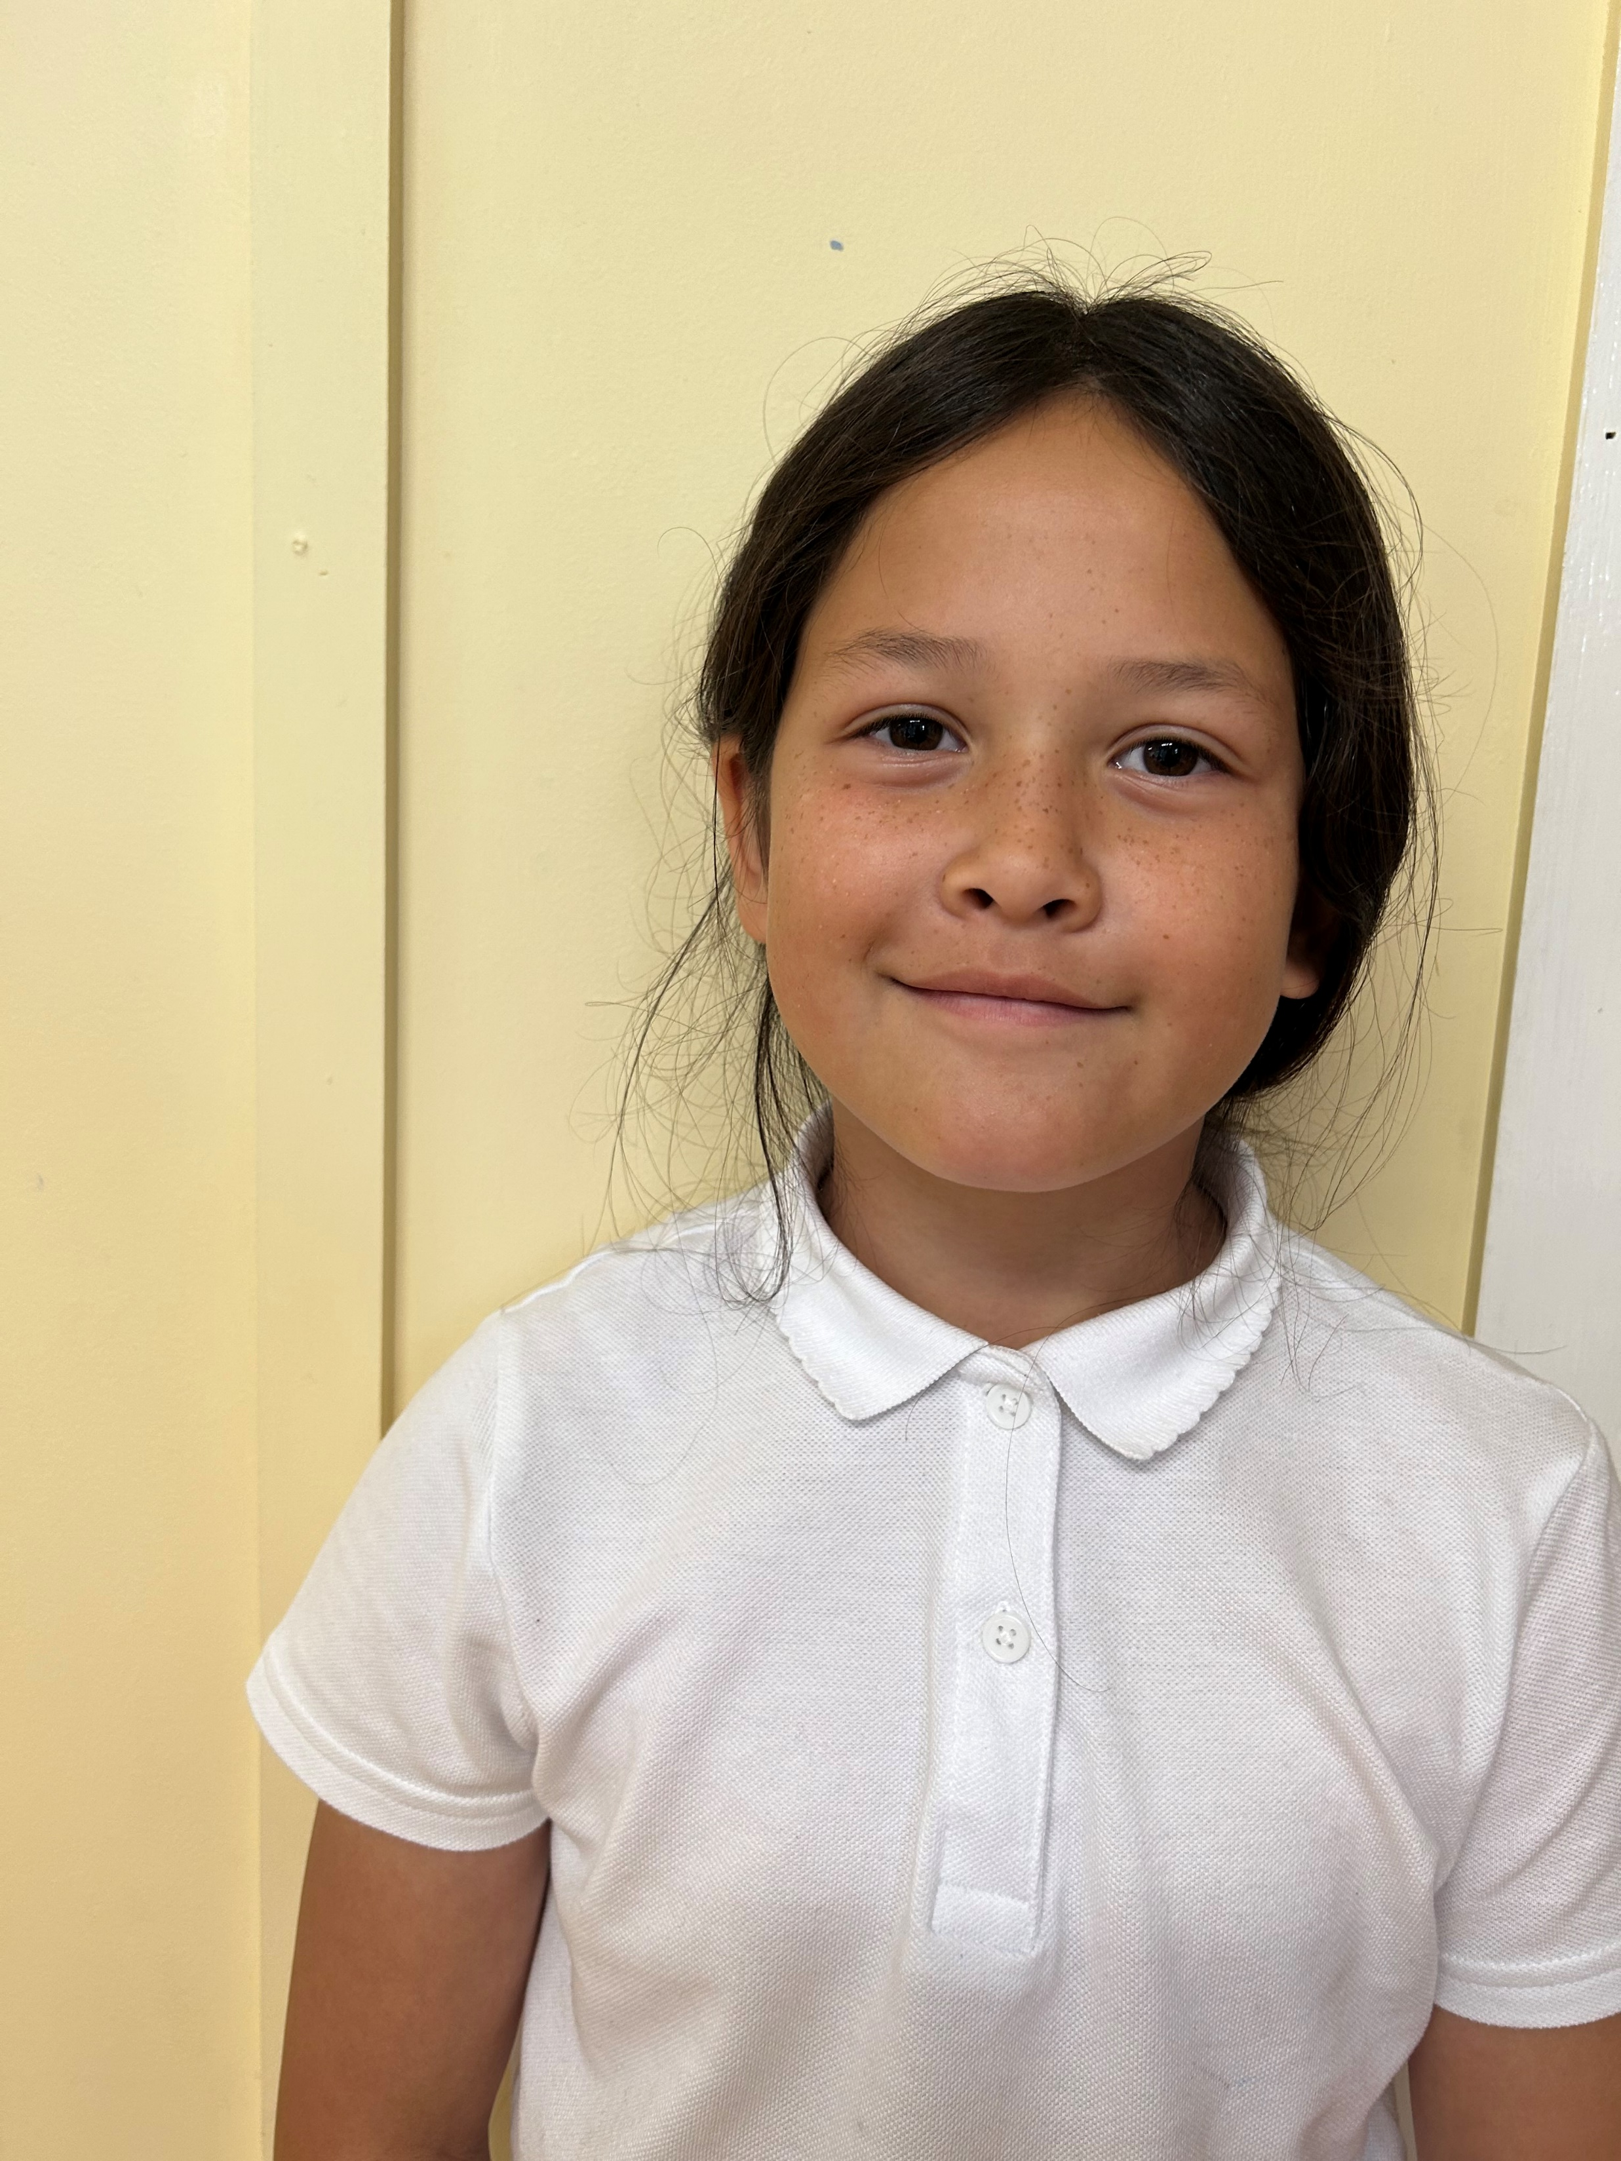
Christina 4th Class
Age: 9
Favourite sport: GAA
“Active School committee sounds like fun to me and I wanted to give it a try!”

Slide 6
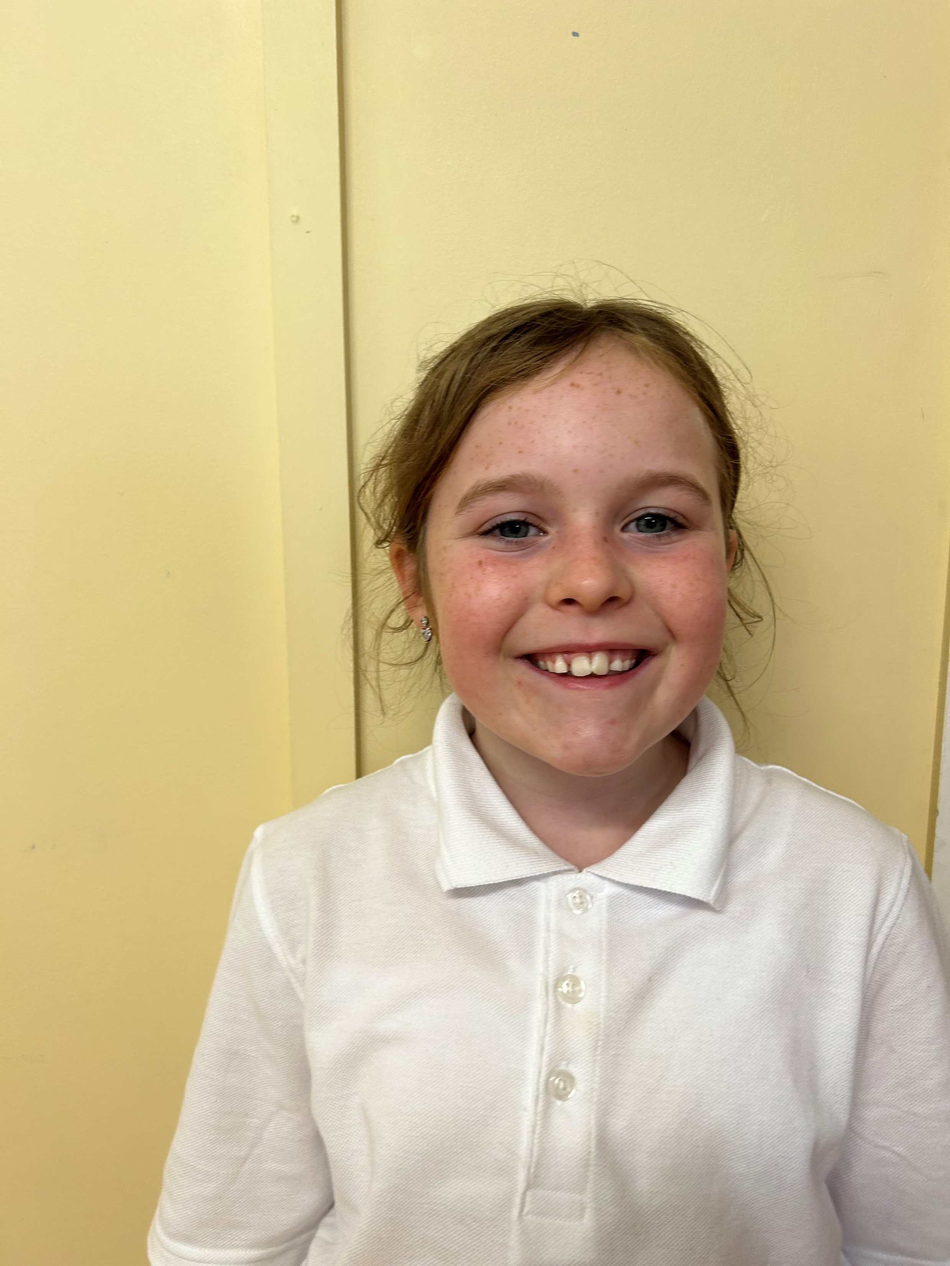
Ava 4th Class
Age: 9
Favourite sport: Camogie
“I love being active and playing outside when I can!”

Slide 7
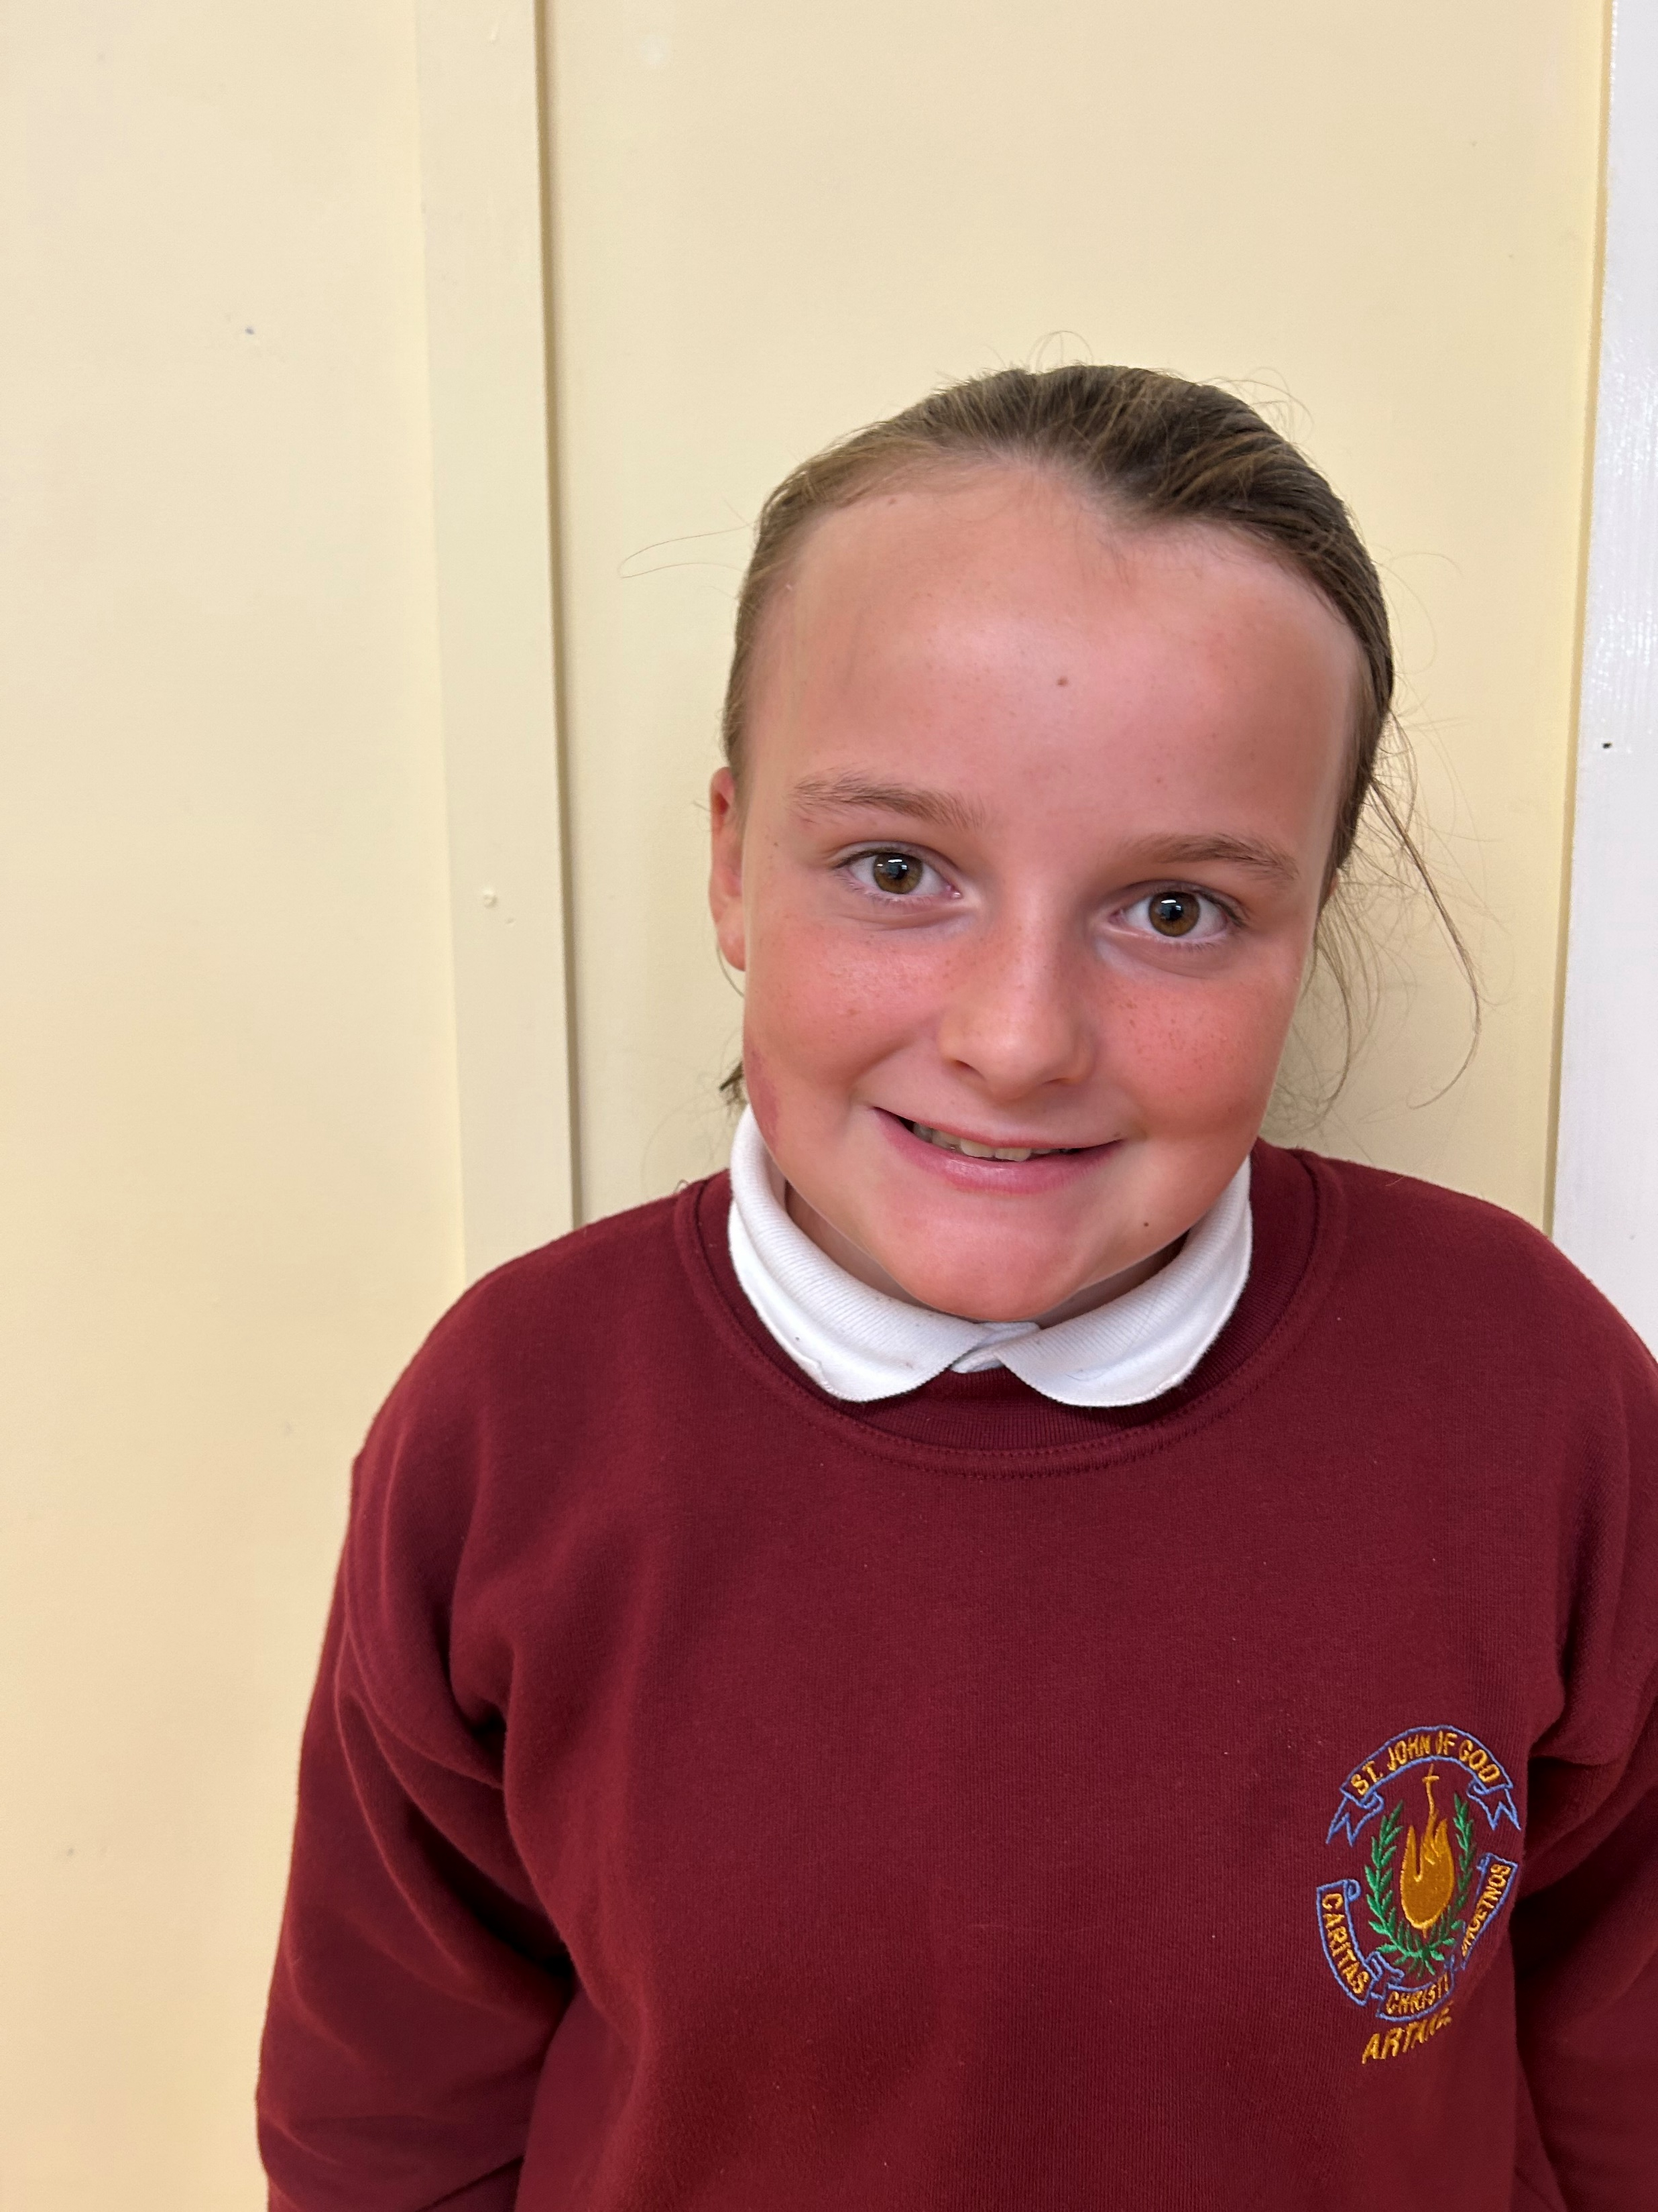
Delilah 5th Class
Age: 11
Favourite sport: Football
“I like being sporty and active!”

Slide 8
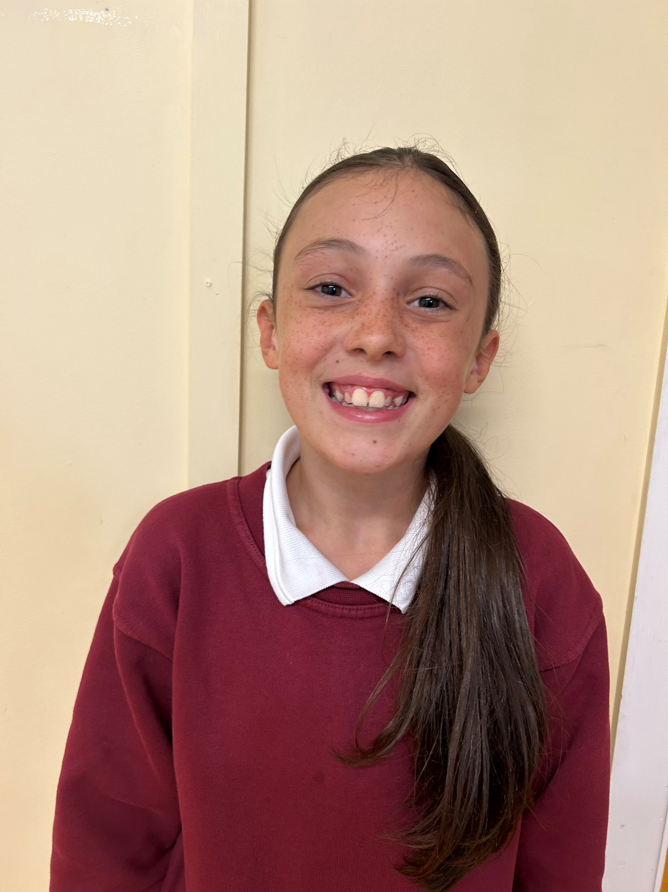
Ally 5th Class
Age: 11
Favourite sport: Ballet, Gymnastics & Football
“I want to support people to be active!”

Slide 9
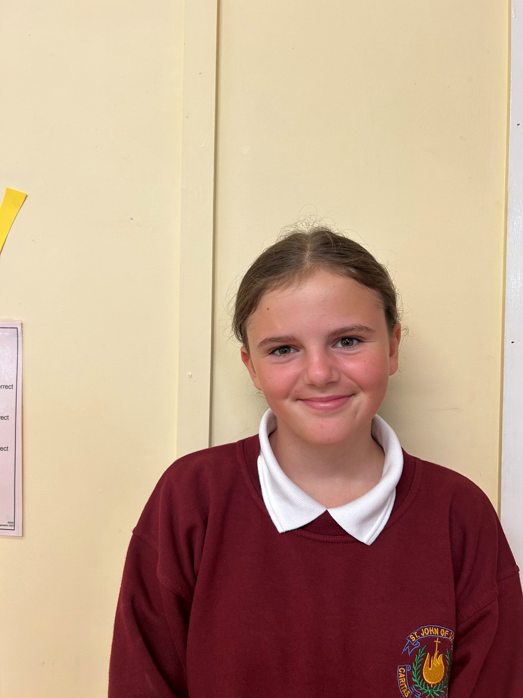
Holly 6th Class
Age: 12
Favourite sport: Horse Riding
“I Love being active and helping out with sport!”

Slide 10
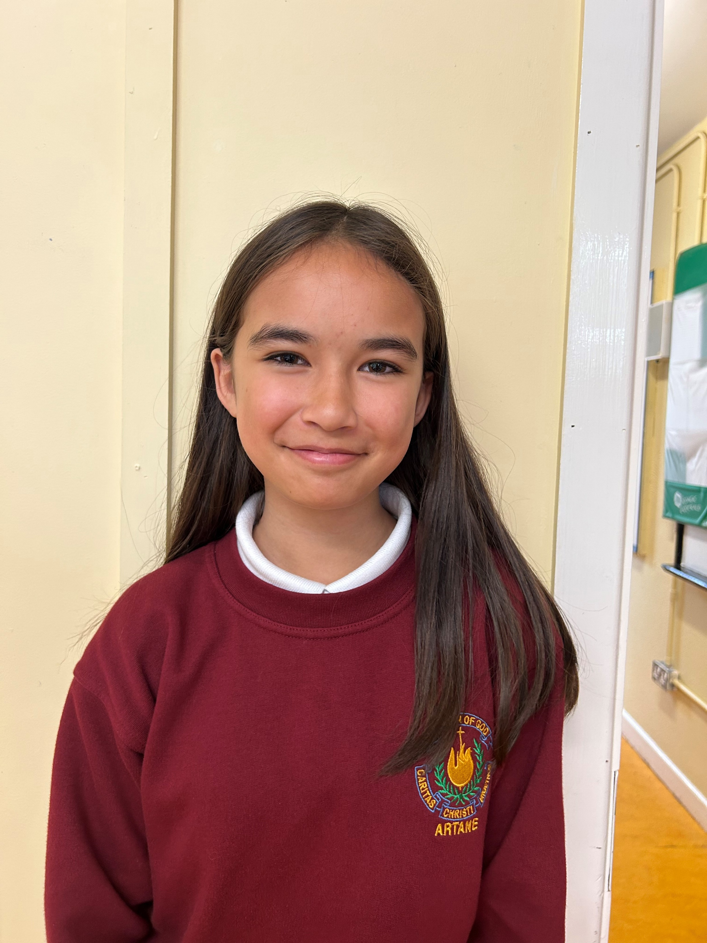
Intira 6th Class
Age: 12
Favourite sport: Horse Riding
“I want to increase activity in the school!”

