Slide 1
Mary PowerPoint
Ask your daughter the questions below each picture and then discuss the answer to the questions together.

Slide 2
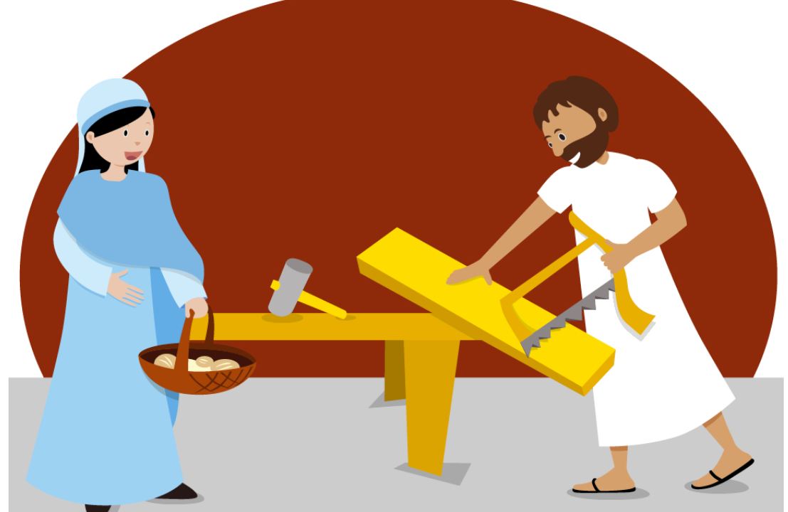
Where did Mary live? Mary lived in Nazareth.
What was Mary’s husband’s name? Joseph

Slide 3
How did Mary find out that she was to be the mother of God’s son? An angel came to Mary to tell her that she would be the mother of Jesus.

Slide 4
What is the name of the town where Jesus was born? Bethlehem

Slide 5
Who is in the picture? Mary, Joseph, Jesus, Anna and Simeon.
Where did Simeon and Anna meet Jesus? In the temple.

Slide 6
How do you think Mary felt when Jesus died?

