Slide 1
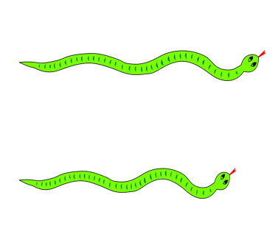
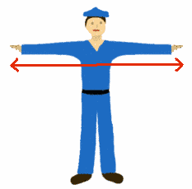
Length

Slide 2
Wednesday

Slide 3
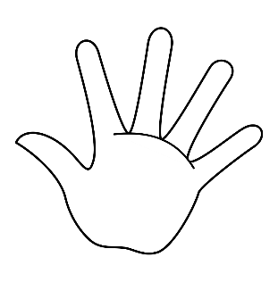
Use your hands/lollipop sticks/cubes/pencils/etc to measure the length of different items in your home.
Here are some examples:
‘How many pencils do you need to measure the length of your kitchen table?’ ‘Do you need more or less pencils to measure the length of your bed?’
How many hands do you need to measure the length of your book?
In this example, you need 3 hands to cover the length of the book.

Slide 4
Steps Challenge
Walk around the house using long/short steps.
Estimate/guess how many long steps it will take to walk from one kitchen wall to the other.
Measure by taking long steps from one side of the kitchen to the other.
Compare the results with your estimations.

Slide 5
Thursday

Slide 6
Make tall/short/narrow/wide shapes using your body.
Arrange everyone in your family from the smallest to the tallest.
Sort your teddy bears into tall, small and medium groups.

Slide 7
Friday

Slide 8
House Hunt
Can you find something in the house that is:
Taller than you
Shorter than you
Longer than a book
Wider than the fridge

Slide 9
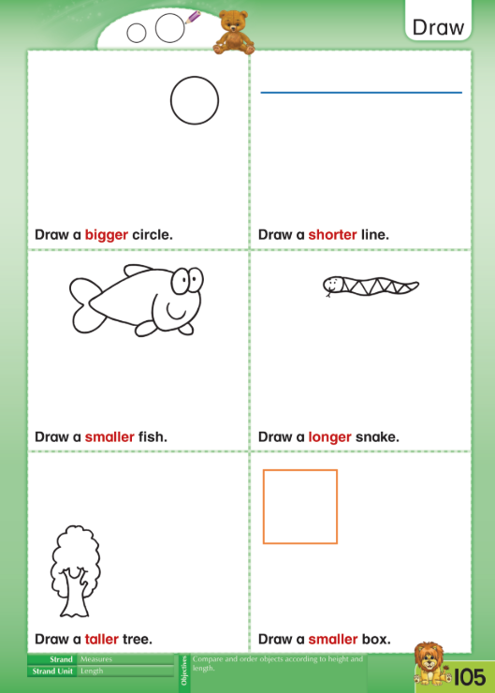
Complete the following activity on a page.
For example:
Draw a circle, then draw a bigger circle.
Draw a line, then draw a shorter line.

